Slide 1
IMDb Movie Analysis
By SARFARAZ AHMED

Slide 2
Project Description
Using the data of IMDB Movies which contains different kinds of data such as Movie tittle , IMDB score , year , actor name , director name etc. Using the dataset answer all the questions to provide a better insight

Slide 3
approach
Started with understanding the data and use of each and every column in the data set. Once after understanding the data, normalizing the data to remove redundancy and Anomalies. Once after data is normalized start with creating necessary new columns for answering the questions .

Slide 4
tech stack used
Microsoft Excel 2016
As the Inbuilt features like Pivot table , sorting data , easy to perform calculations and easy to visualize the data .

Slide 5
Insights
Importance of data cleaning and how to decide which data is necessary and which is not . How using the Pivot table can simplify the process of analyzing the data and visualizing the data . How grouping the data can answer different kind of questions. Importance of statistics in data analysis .

Slide 6
Results
A. Cleaning the data
Removing the rows which have null or no data in a cell
Delete the columns which are not needed actor_2_name , actor_3_name, director_facebook_likes , actor_3_facebook_likes, actor_1_facebook_likes, cast_total_facebook_likes, facenumber_in_poster, plot_keywords, movie_imdb_link, content_rating, title_year, actor_2_facebook_likes aspect_ratio, movie_facebook_likes.
Final columns after cleaning the data .

Slide 7
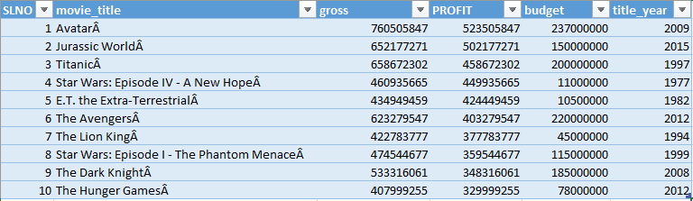
B. Movies with highest profit : Find the movies with the highest profit?
For all the movies in the data set

Slide 8
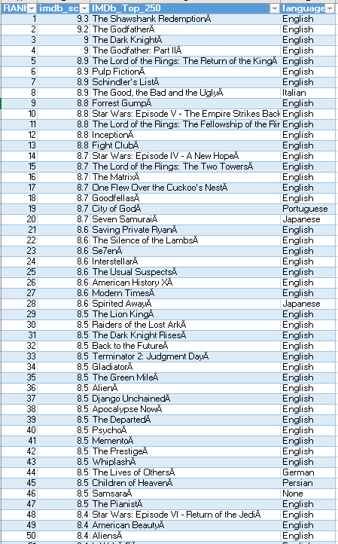
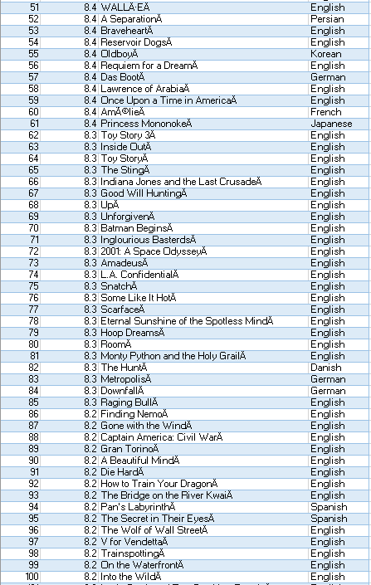
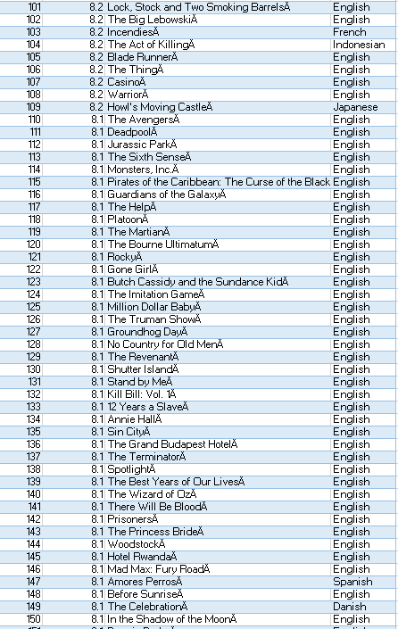
C. Top 250: Find IMDB Top 250

Slide 9
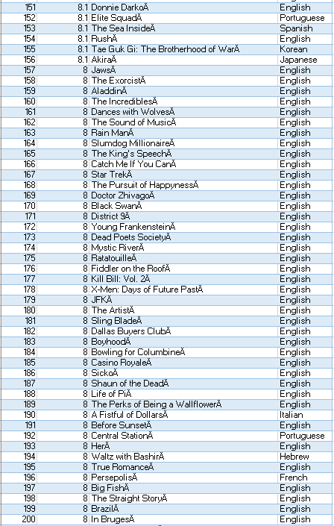
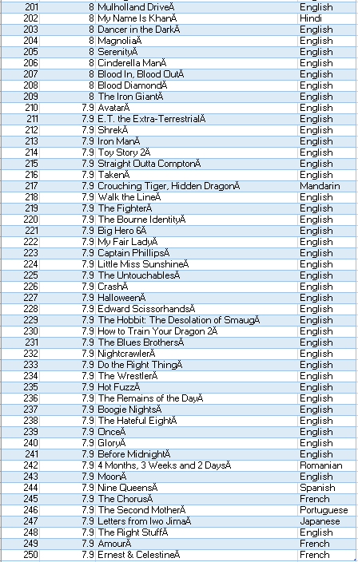

Slide 10
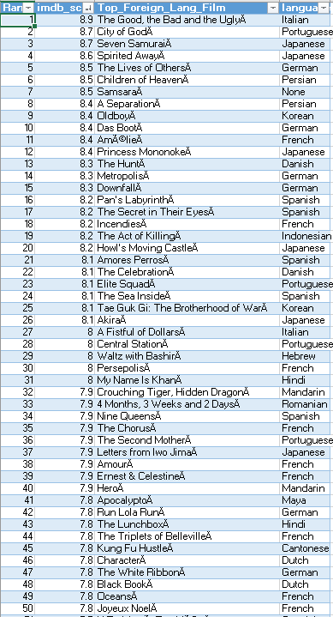
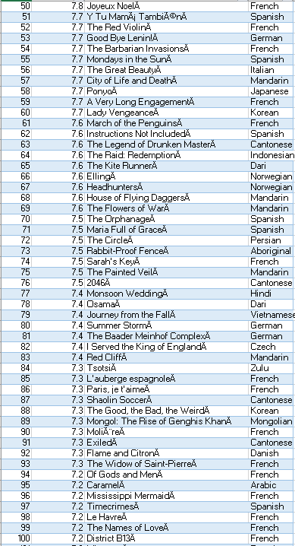
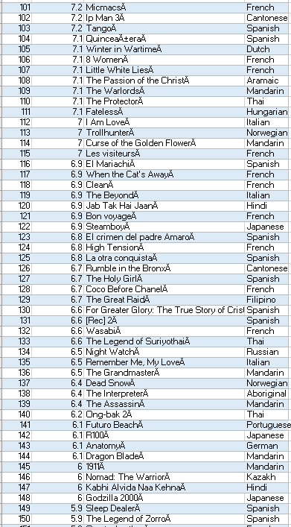
C. Top 250: Find IMDB Top 250 Foreign movies

Slide 11
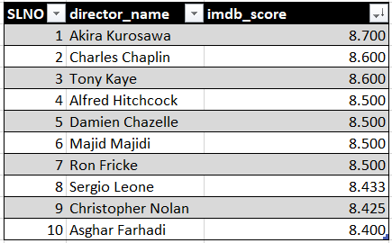
D. Best Directors: Find the best directors

Slide 12
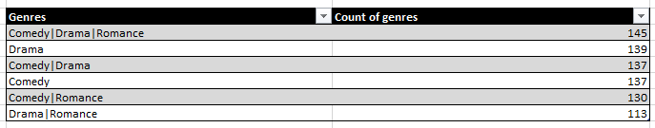
E. Popular Genres: Find popular genres

Slide 13
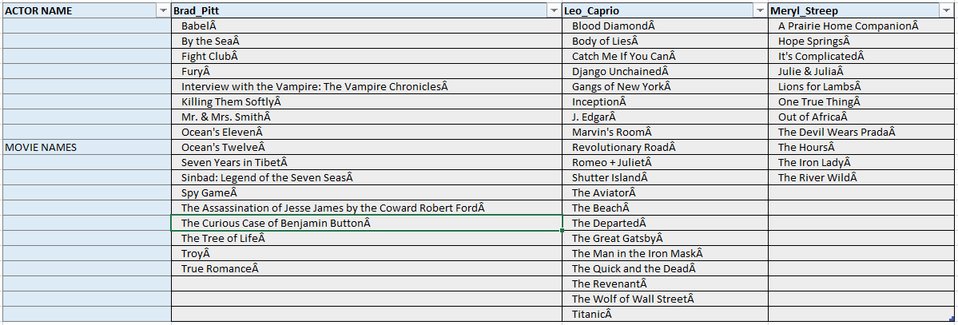
F. Charts:Find the critic-favorite and audience-favorite actors
MOVIES DONE BY THE ACTORS Brad Pitt , Leonardo DiCaprio , Meryl Streep

Slide 14
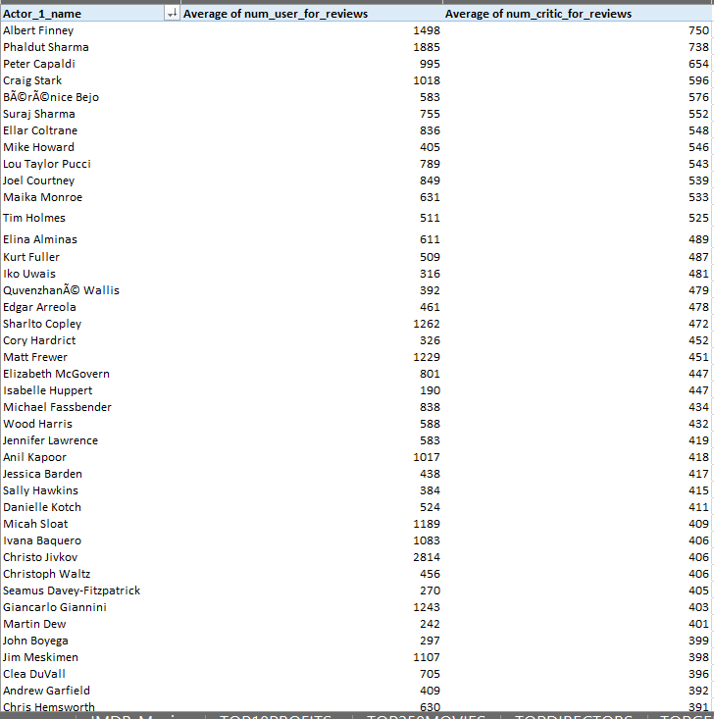
CRITIC FAVOURITE ACTOR AND USER FAVOURITE ACOTR

Slide 15
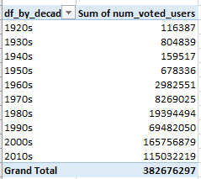
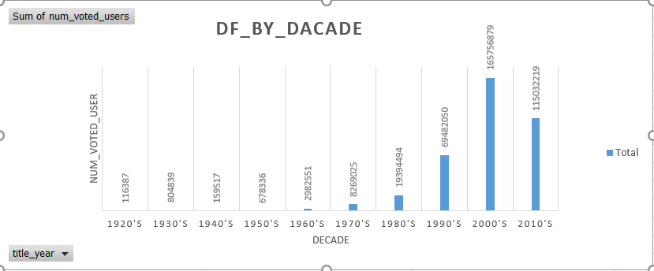
Number of voted users over decades

Slide 16
HYPER LINK TO FINAL EXCEL FILE
https://docs.google.com/spreadsheets/d/1rNuMhJlTA7mQx-w2Z2lSN8UrRdiyjjWY/edit?usp=drive_link&ouid=112349825885166255529&rtpof=true&sd=true
NOTE : VIEW THE FILE IN M.S.EXCEL 2016 FOR ALL THE FEATURES TO WORK PROPERLY

